Slide 1
MCTV
Team I

Slide 2
Introduction to our company
MCTV was founded by Michael Cooney and his wife Doreen.
Michael has profession of Electronic Engineer
It is a private limited company that runs over twenty years in business.
It is located in Limerick
It is a small retail business company with a staff of 4 family members and a shop assistant.
Their annual turnover per annum is €1 million.
The 4 family members are Derek, the eldest son who manage the sales and marketing, Roberta a qualified accountant and aspires and the Twin brothers Mark and Liam who are studying their final year in University of Limerick. Mark is studying computer science and Liam who spend a lot using social media and collaborative software
The other staff is John that is employed as a shop assistant and doing part- time work every Tuesday and Saturday.

Slide 3
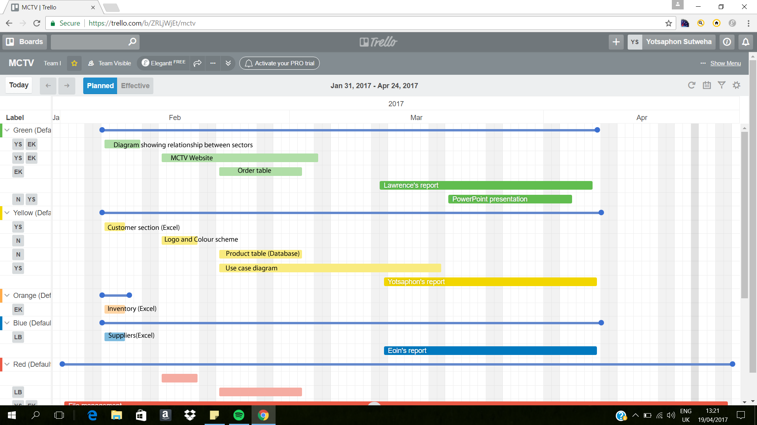
Group Task – Gant Chart

Slide 4
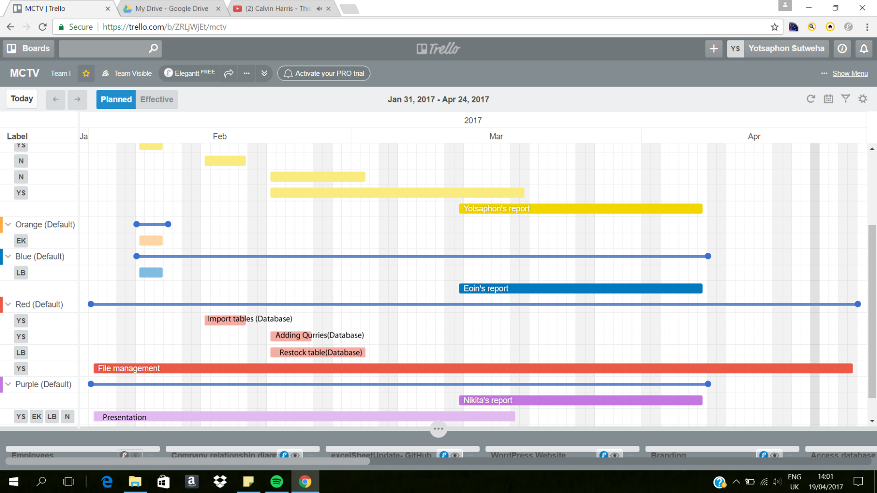

Slide 5
Overview of Database
Tables
Customers
Inventory
Order
Product Detail
Restock
Suppliers
Example

Slide 6
Overvie
Queries
Retail Structure Customer
Suppliers vans Delivery

Slide 7
Forms
Customer
Home
Inventory
Order Table
Product Table
Suggestion Form
Supplier

Slide 8
Reports
MCTVCustomer
MCTVInventory
MCTVSupplier
Order Table
Product Table

Slide 9
Overview of UML chart

Slide 10
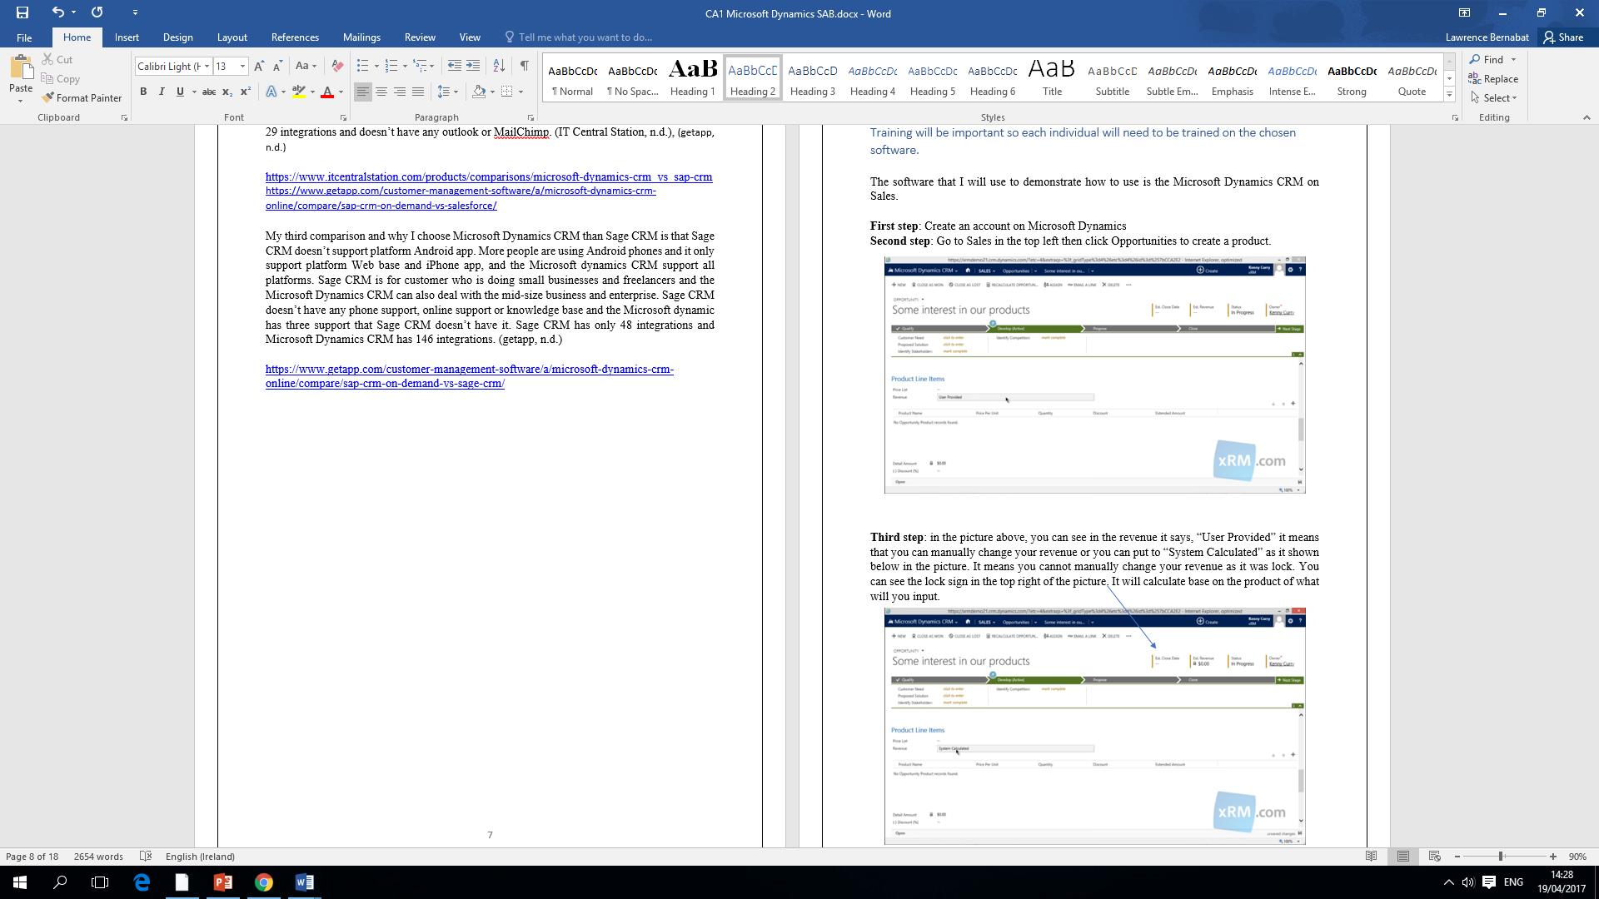
The Software that I investigated is Microsoft Dynamics

Slide 11
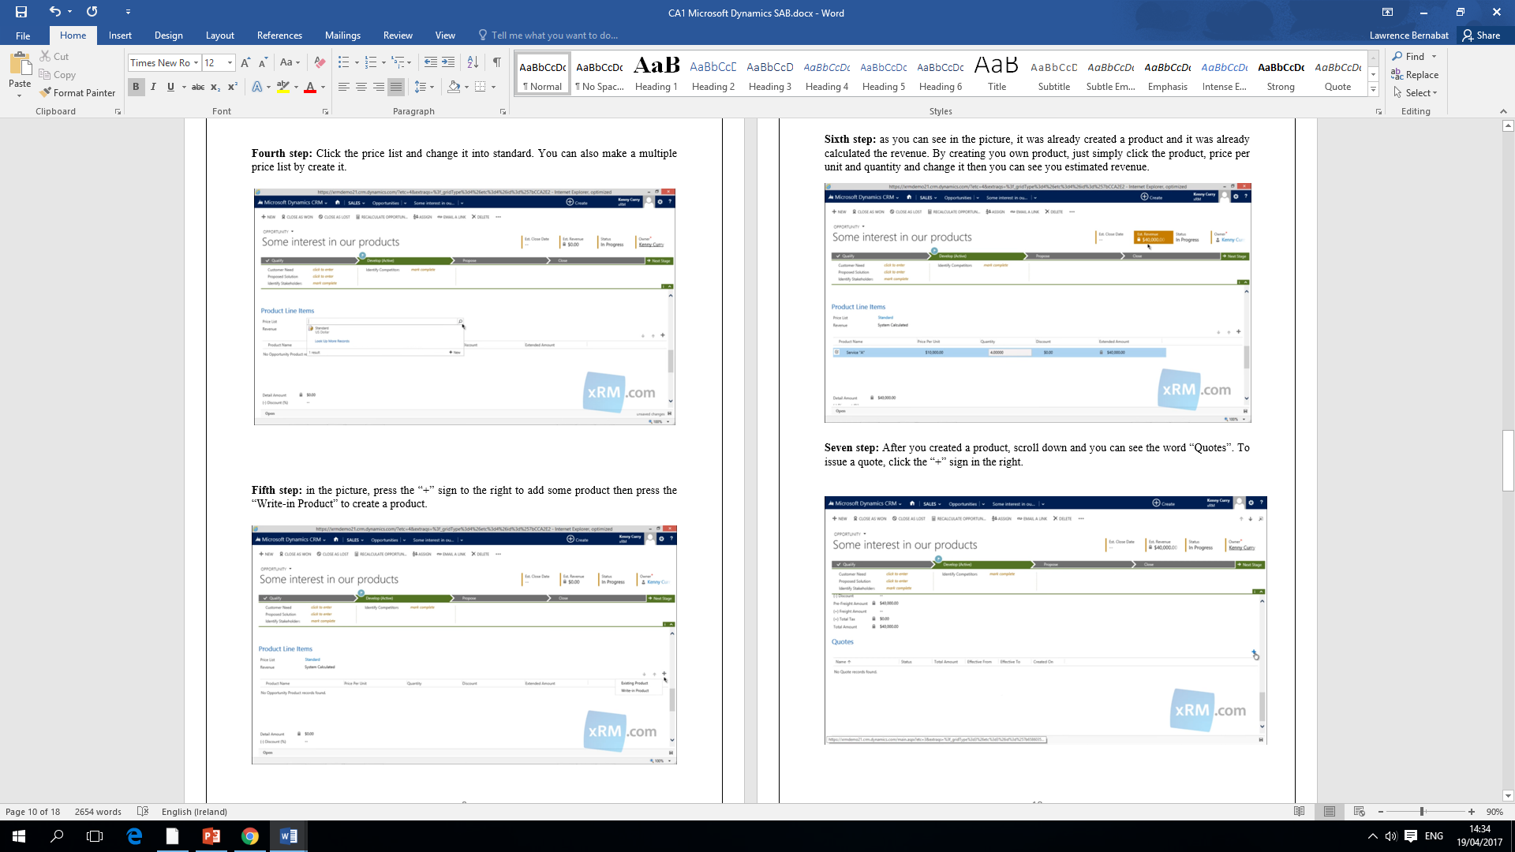

Slide 12
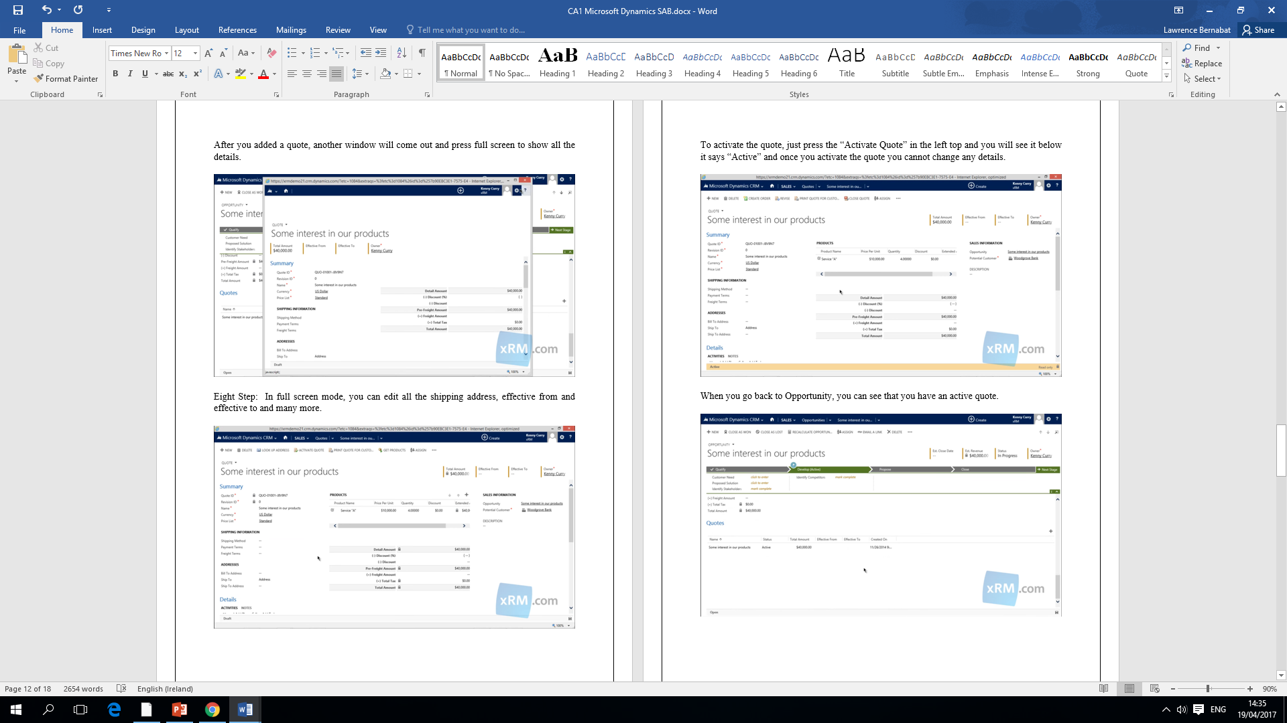

Slide 13
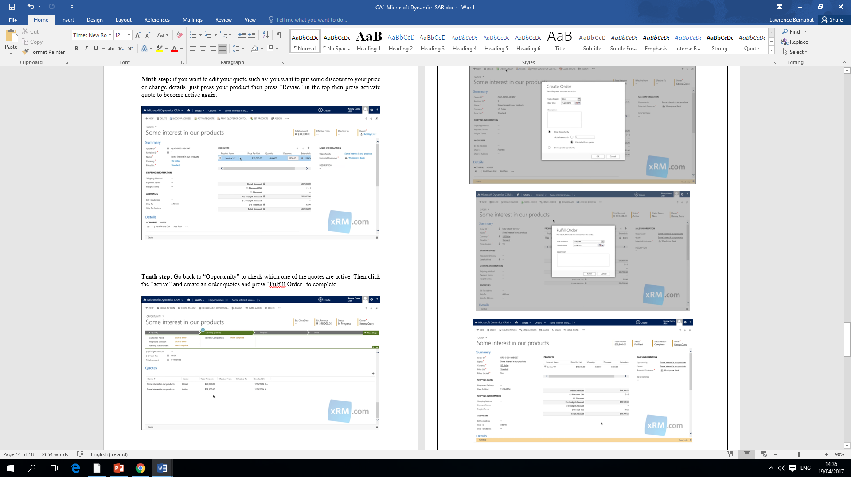

Slide 14
Branding – Colour Scheme
Black
Yellow
Green

Slide 15
Future Development of the Company
In 10 years time, They can expand their Company throughout Ireland.
Company will get more employees.
More Awards such as; Best company in Ireland and Most Successful business in 2017
More customers will buy or order the product
The company will get more partnerships in the business such as; Argos and PC World

